Slide 1
FPGA Final Project:
Elliptic Curve Cryptography
Team memebers:
F64096114 郭家佑
E24096213 蔡奇佑
E14071025 趙泓瑞

Slide 2
Outline
Introduction to ECC
Algorithm & Hardware Architecture
Design features
Results
Problems to occur

Slide 3
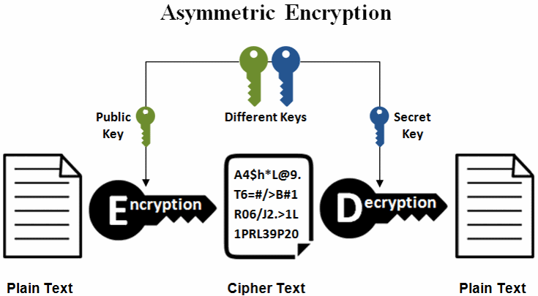
Introduction to ECC

Slide 4
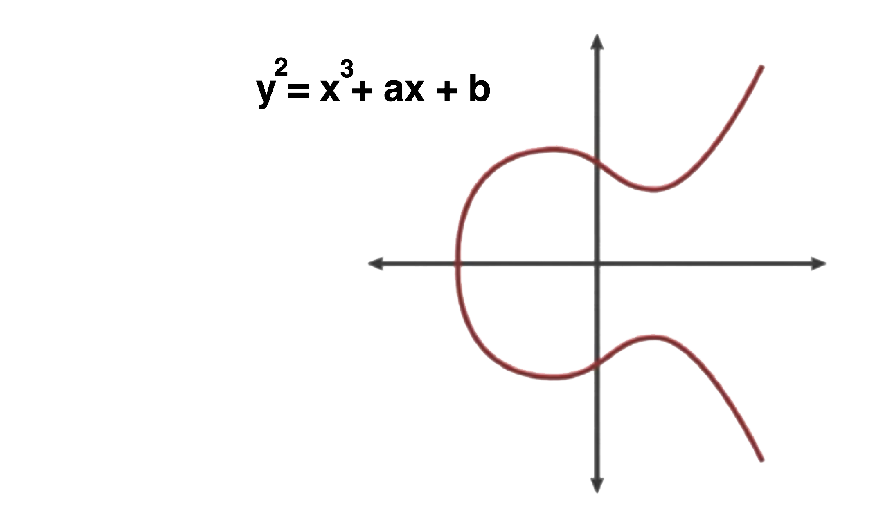
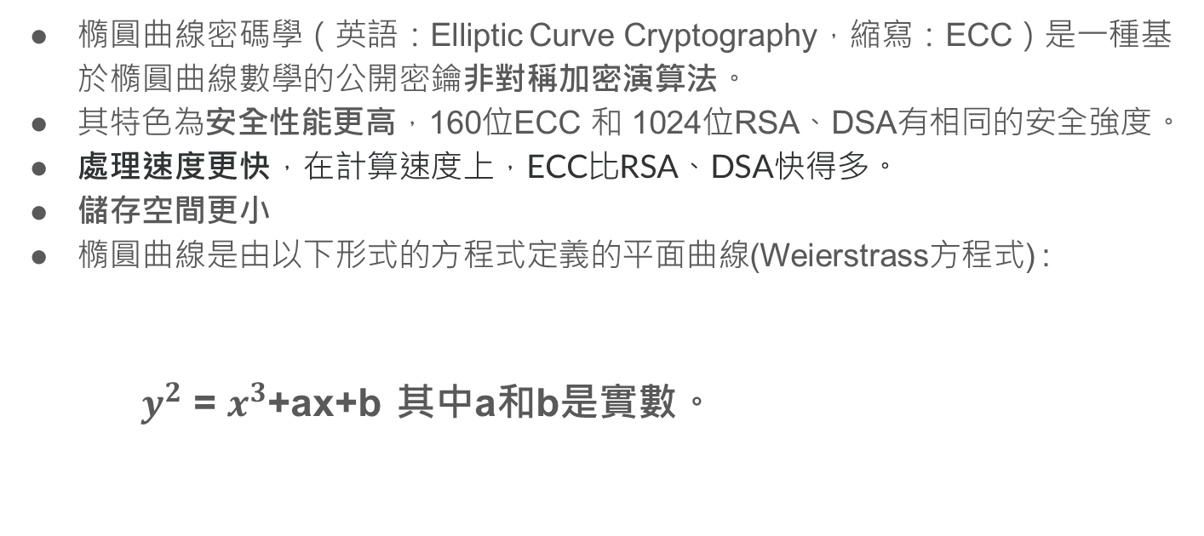
Introduction to ECC
橢圓曲線密碼學（英語：Elliptic Curve Cryptography，縮寫：ECC）是一種基於橢圓曲線數學的公開密鑰非對稱加密演算法。
其特色為安全性能更高，160位ECC 和 1024位RSA、DSA有相同的安全強度。
處理速度更快，在計算速度上，ECC比RSA、DSA快得多。
儲存空間更小
橢圓曲線是由以下形式的方程式定義的平面曲線(Weierstrass方程式) :
$y^{2}$ = $x^{3}$+ax+b 其中a和b是實數。

Slide 5
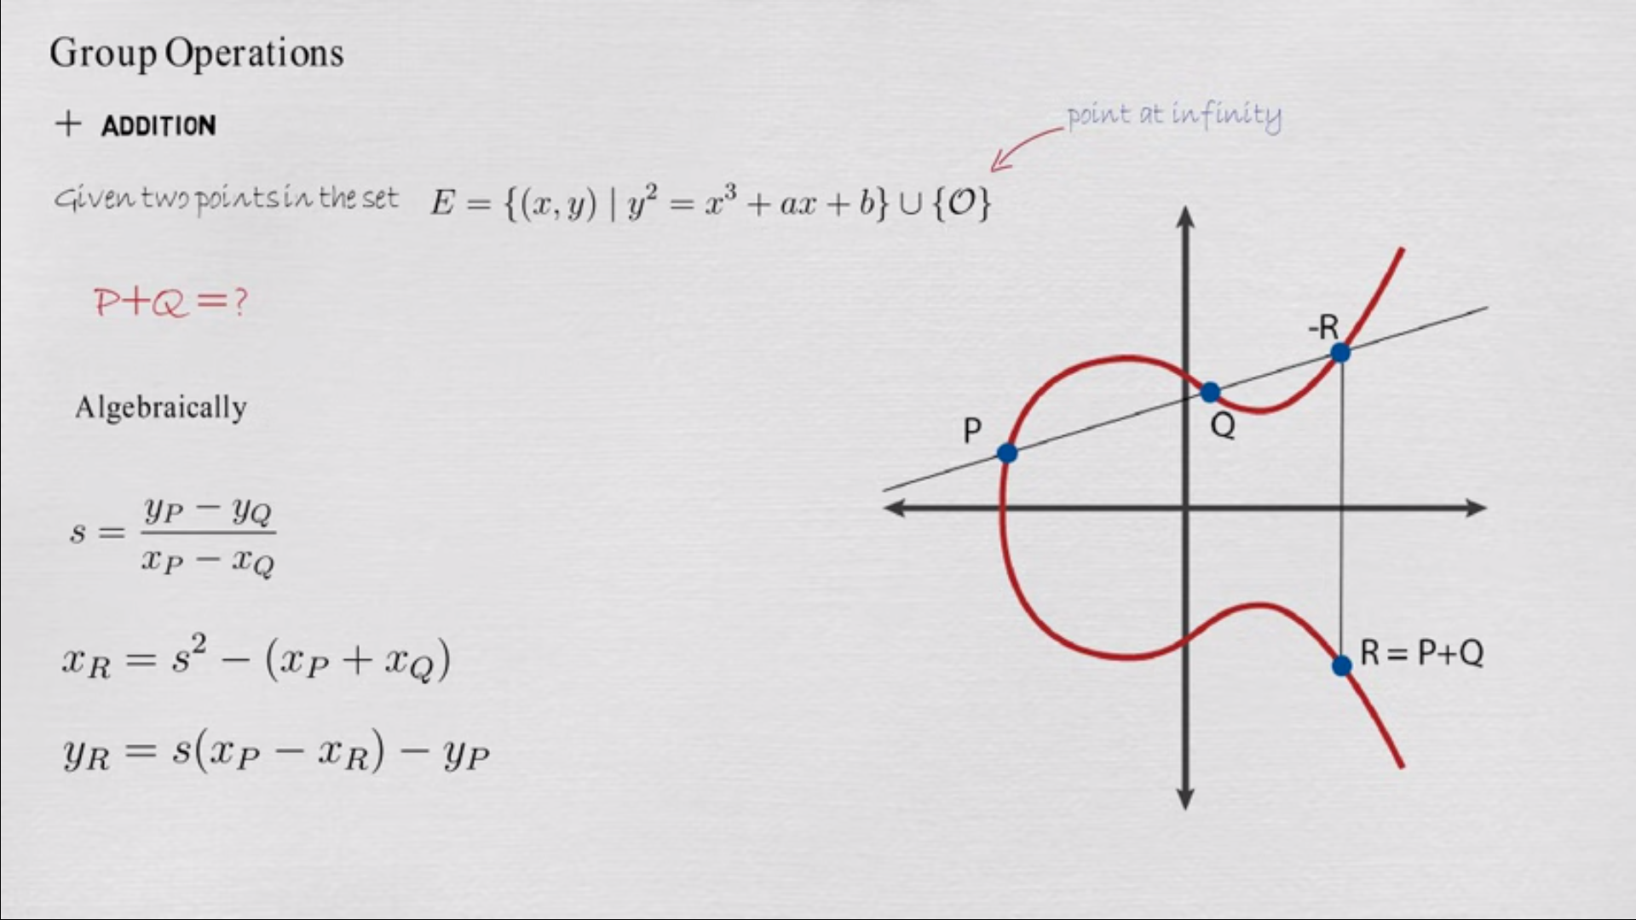
Introduction to ECC - point addition

Slide 6
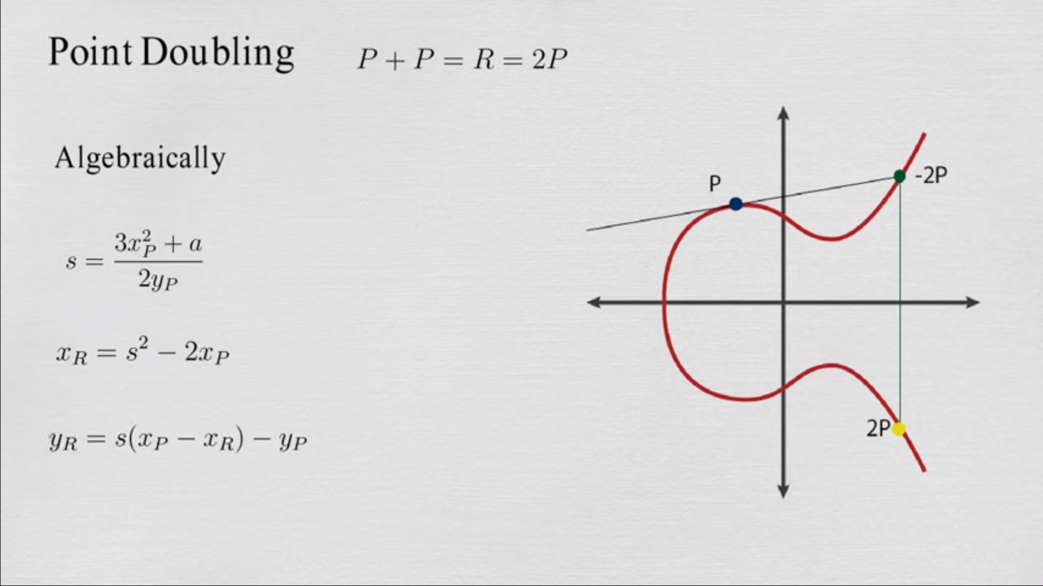
Introduction to ECC - point doubling

Slide 7
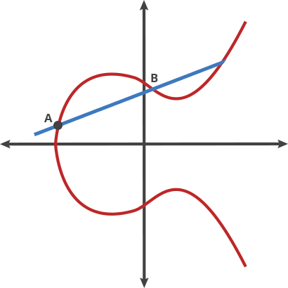
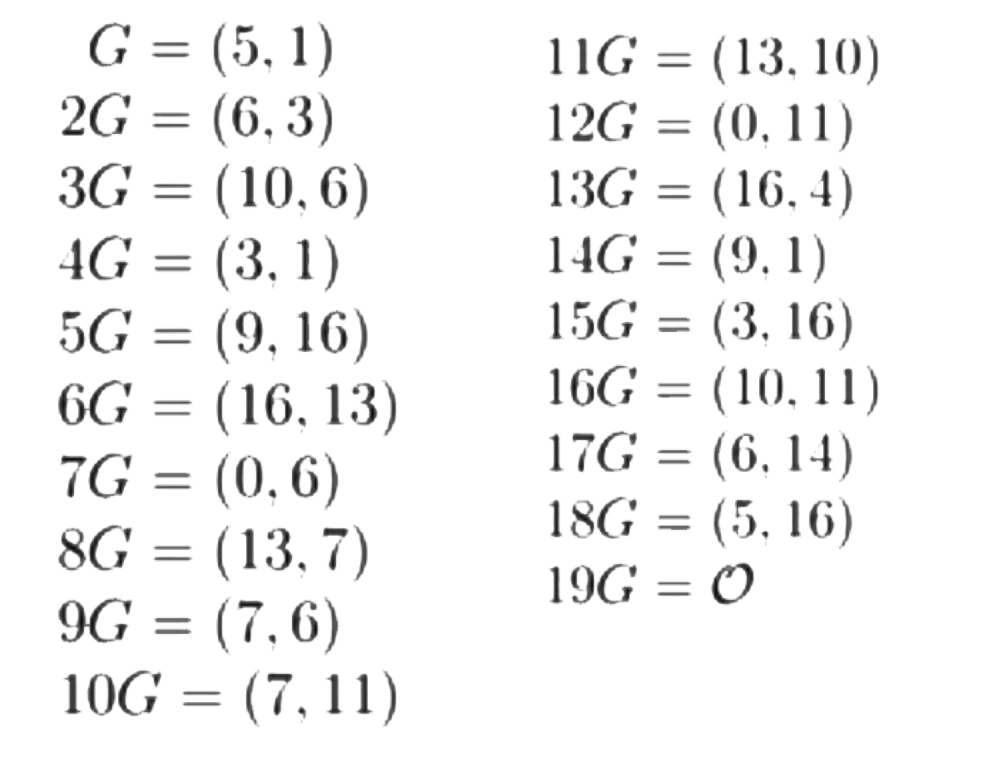
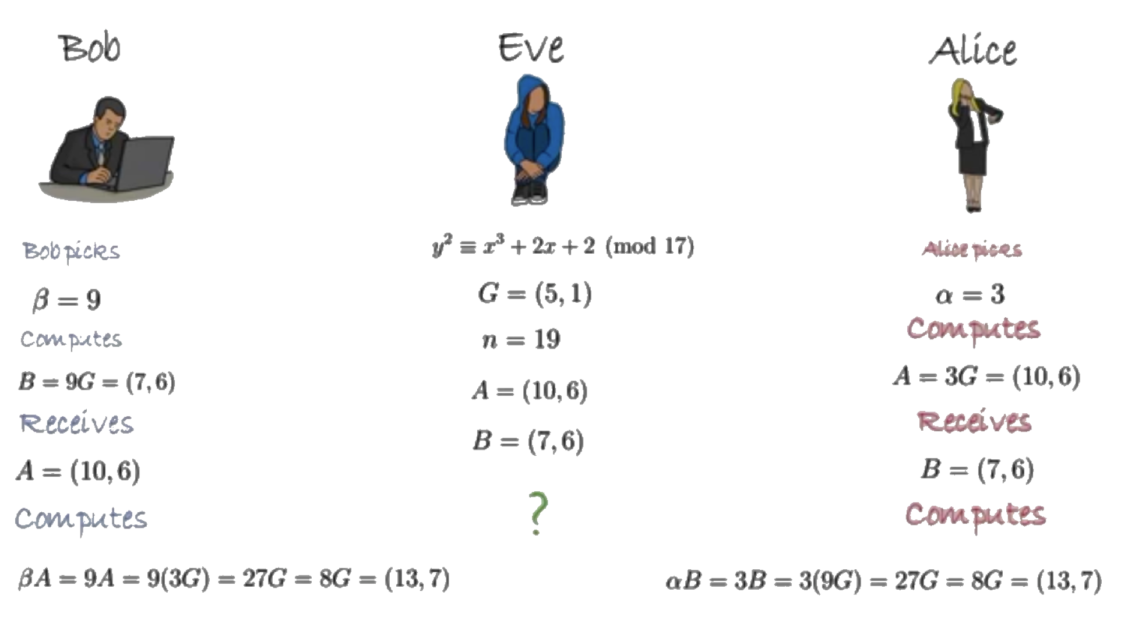
Introduction to ECC

Slide 8
Outline
Introduction to ECC
Algorithm & Hardware Architecture
Design features
Results
Problems to occur

Slide 9
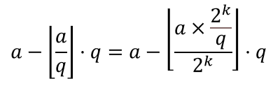
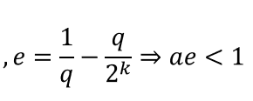
Algorithm – modulus (version1: use pre-division and shift)
It replace division operation with multiply and shift
However it would error when input is close to its bandwidth limit (128bits) since error rate.
a % q =

Slide 10
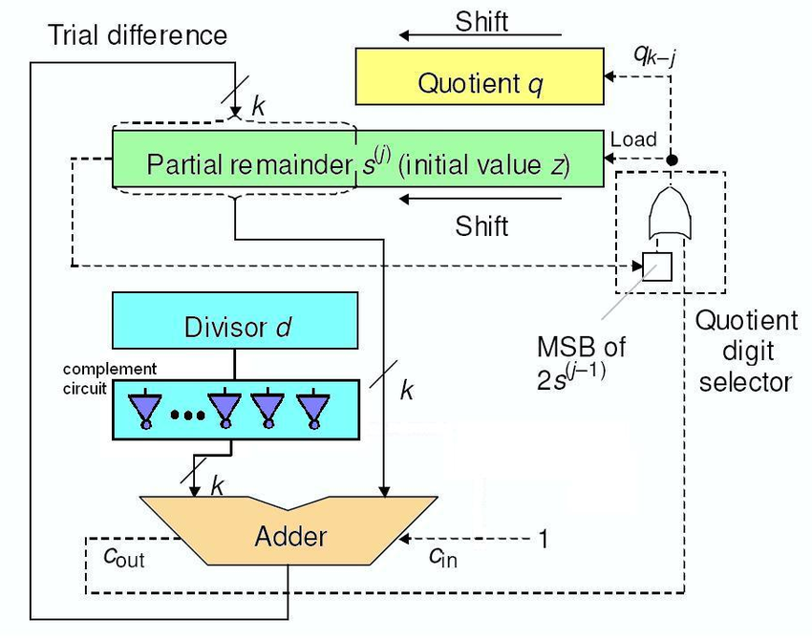
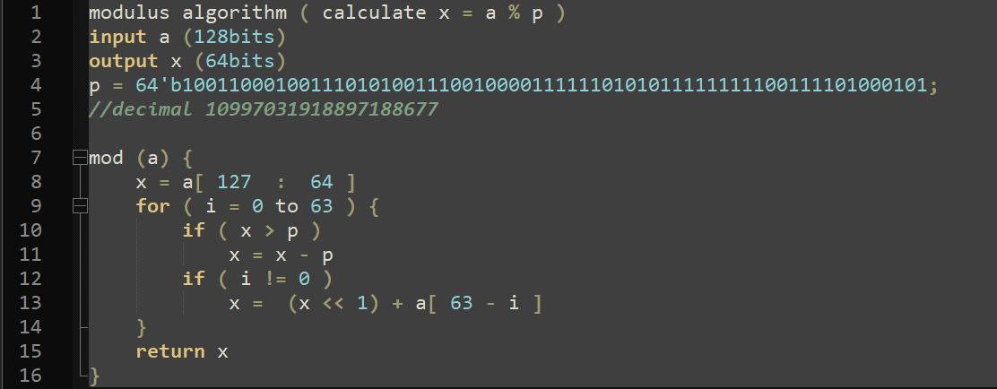
Algorithm – modulus (sol2 :直式除法)
We use sequential divider instead
It cost less clk cycle (66/2) than previous version (64*2)

Slide 11
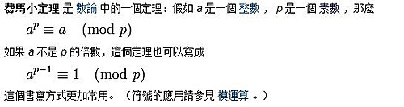
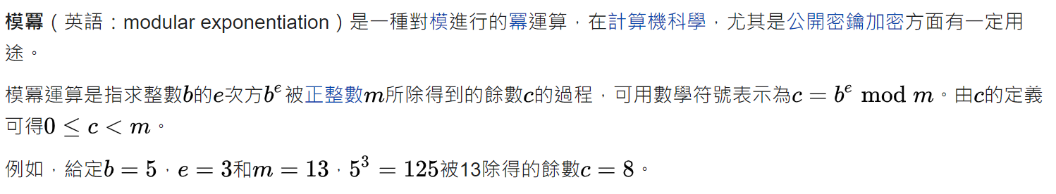
Algorithm – inv_mod (費馬小定理 & 模冪)
費馬小定理
模冪定理

Slide 12
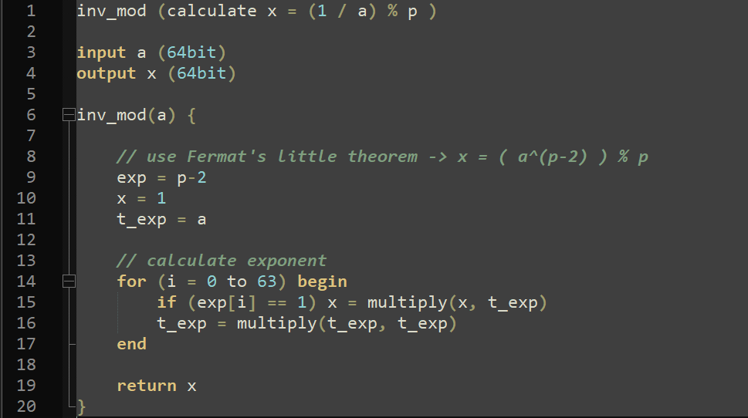
Algorithm – inv_mod (費馬小定理 & 模冪)

Slide 13
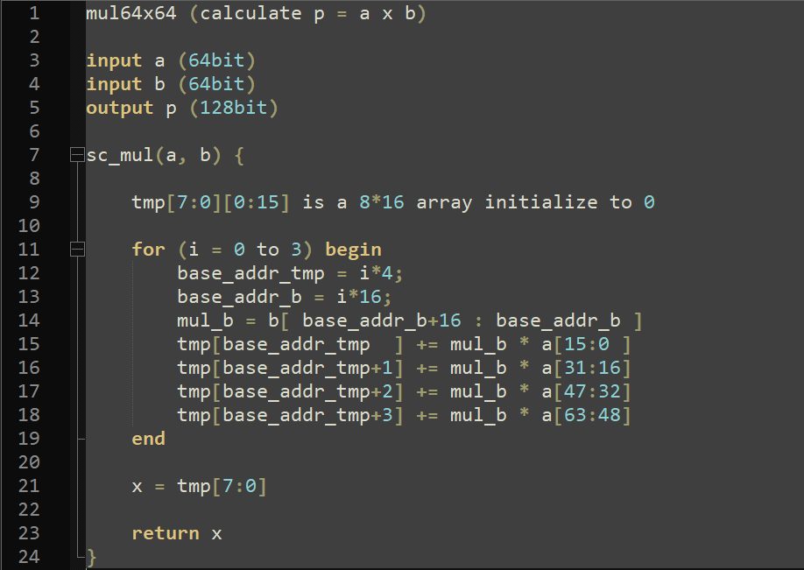
Algorithm – mul64x64

Slide 14
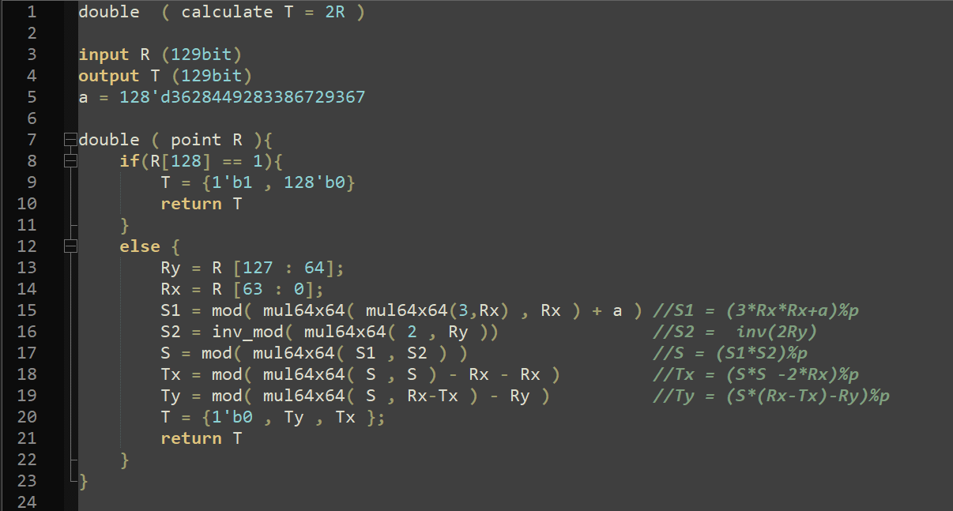
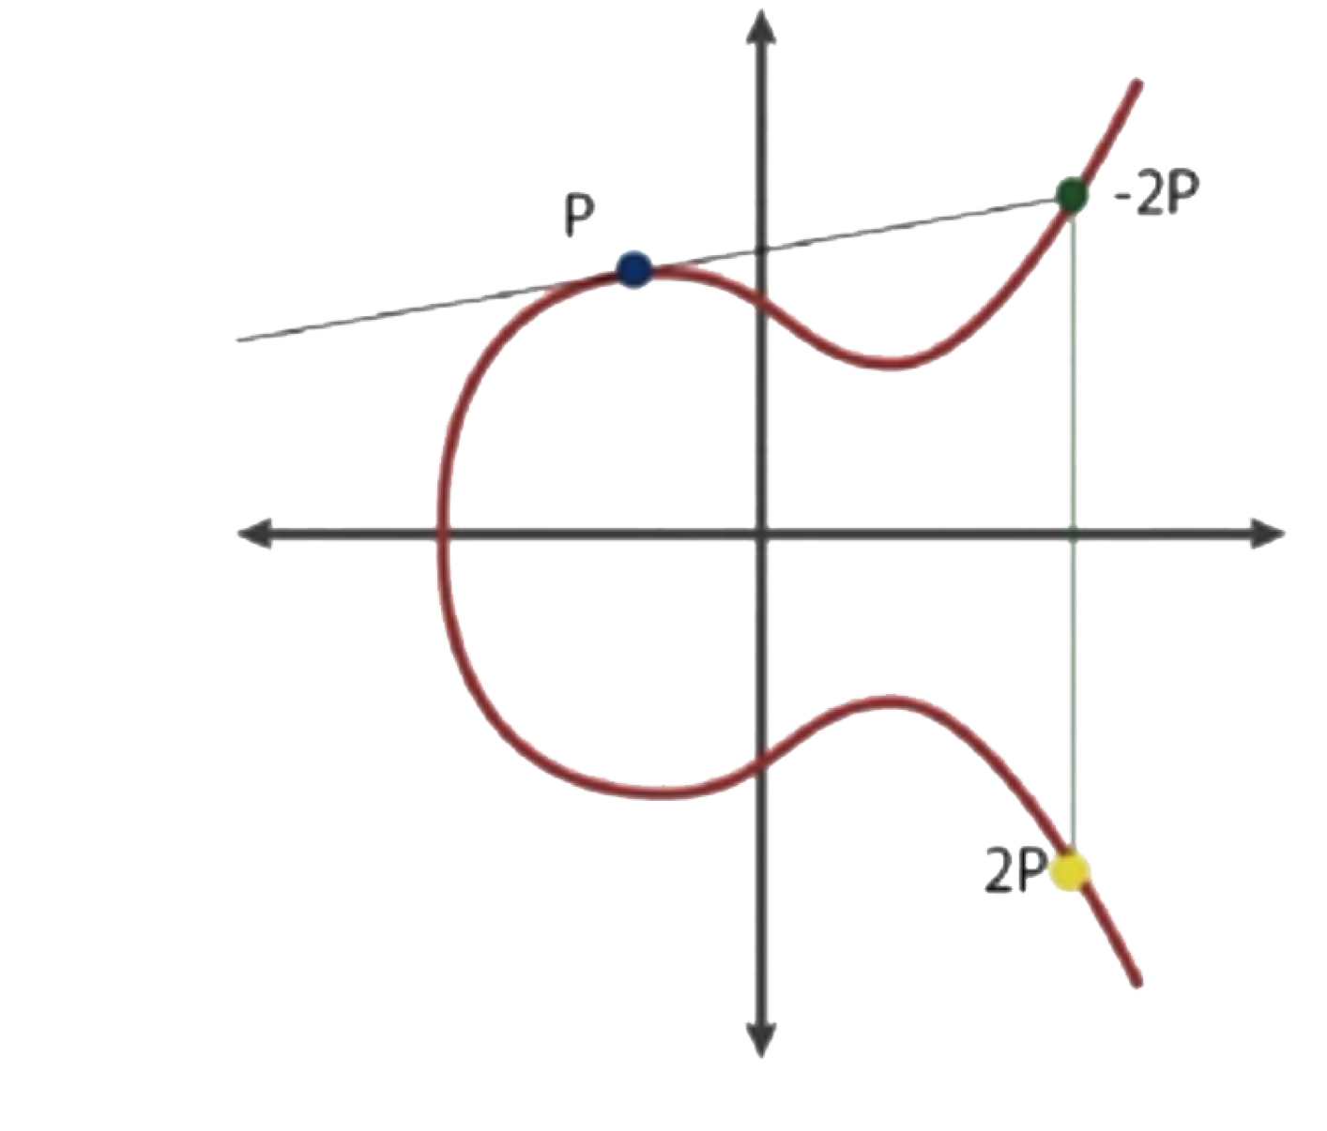
Algorithm – double

Slide 15
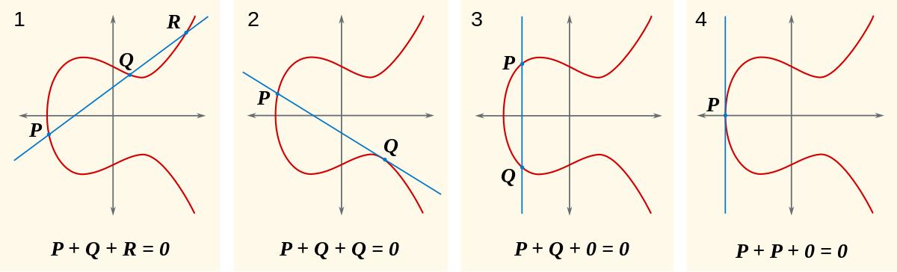
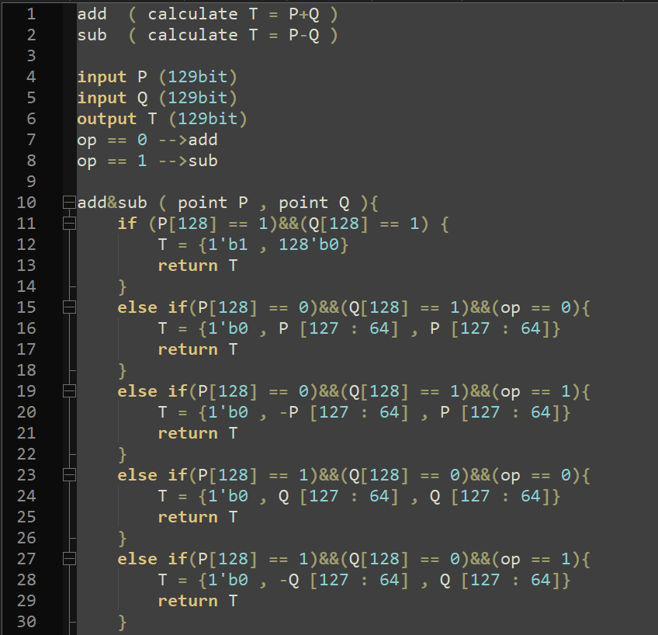
Algorithm – add&sub

Slide 16
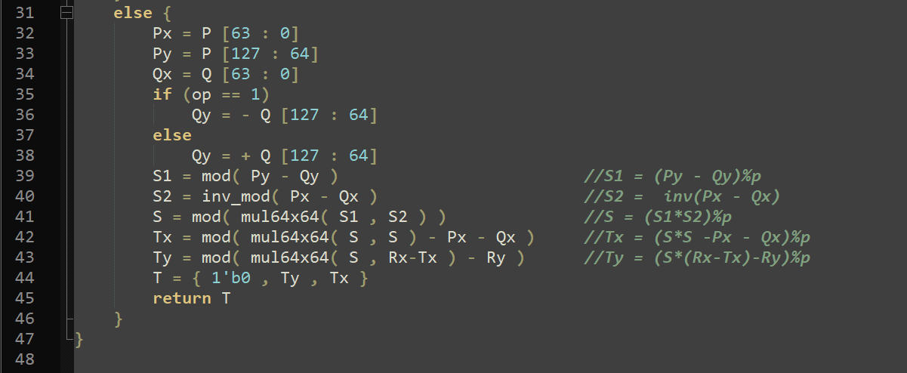
Algorithm – add&sub

Slide 17
Algorithm double vs. add&sub
Point addition
Point subtraction
Point double
Resource sharing for 3 functions in one architecture.
→ Control unit of ALU

Slide 18
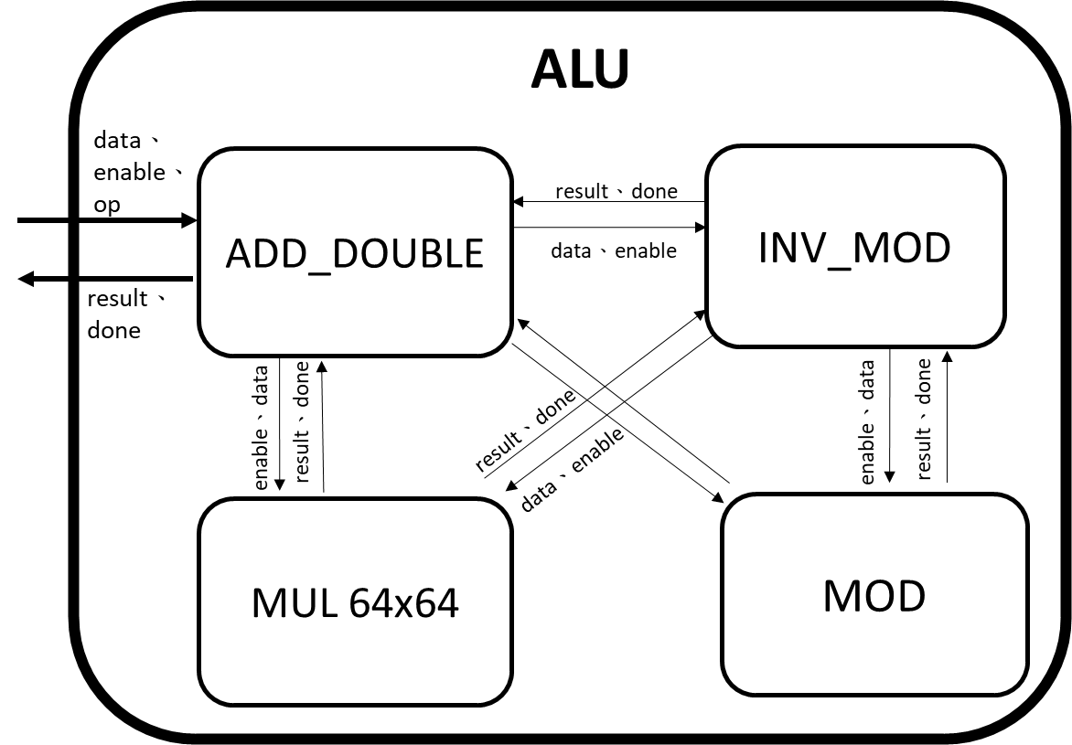
ALU Hardware Architecture

Slide 19
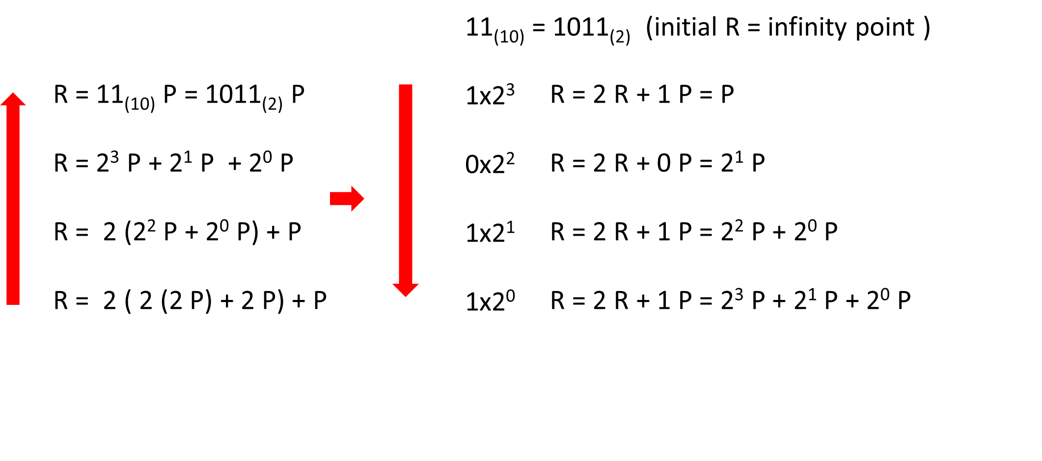
Introduction to ECC – scalar multiplication

Slide 20
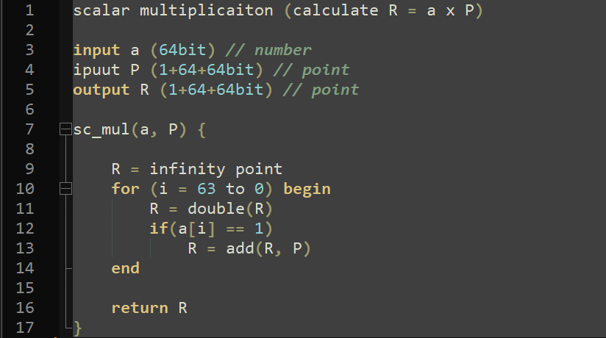
Algorithm – scalar multiplicaiton

Slide 21
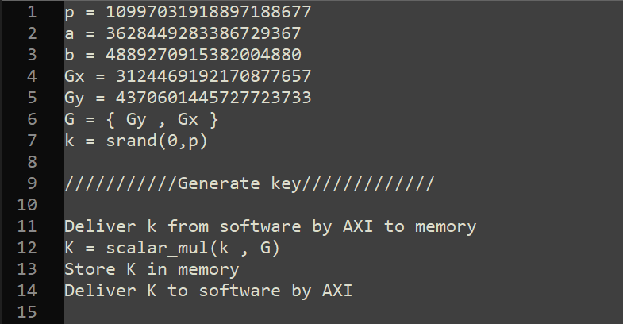
Algorithm – generate key

Slide 22
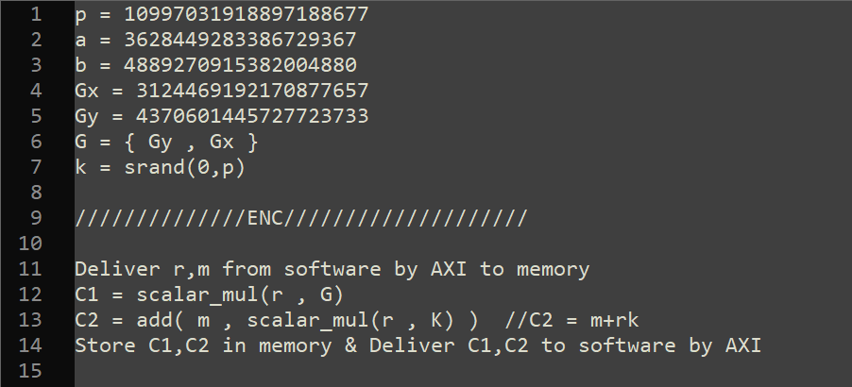
Algorithm – Encryption

Slide 23
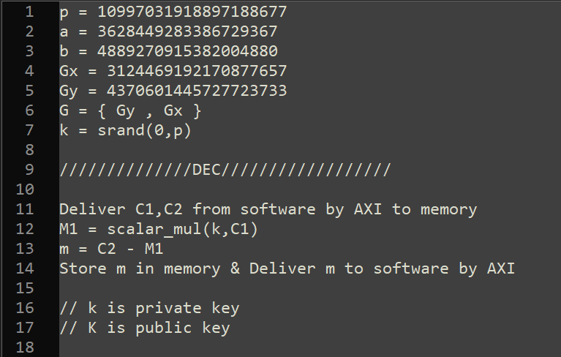
Algorithm – Decryption

Slide 24
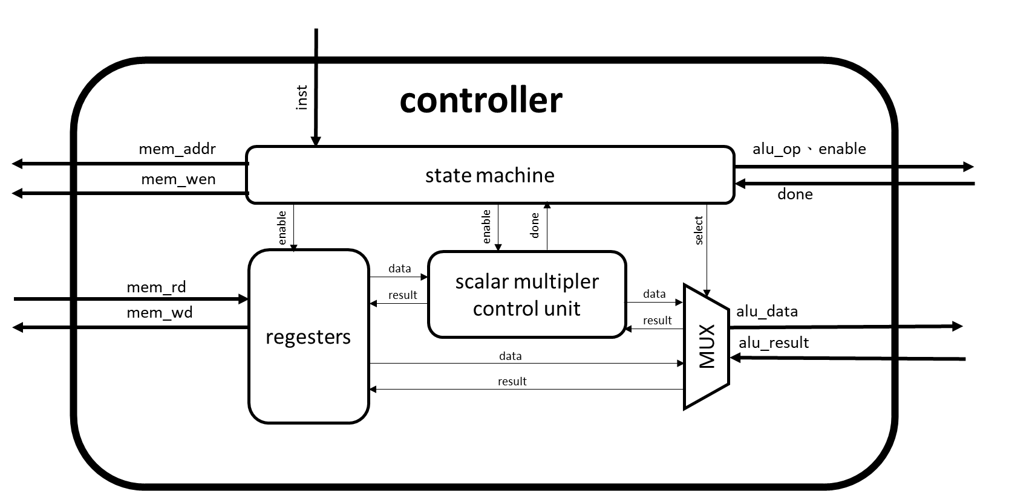
Controller Hardware Architecture

Slide 25
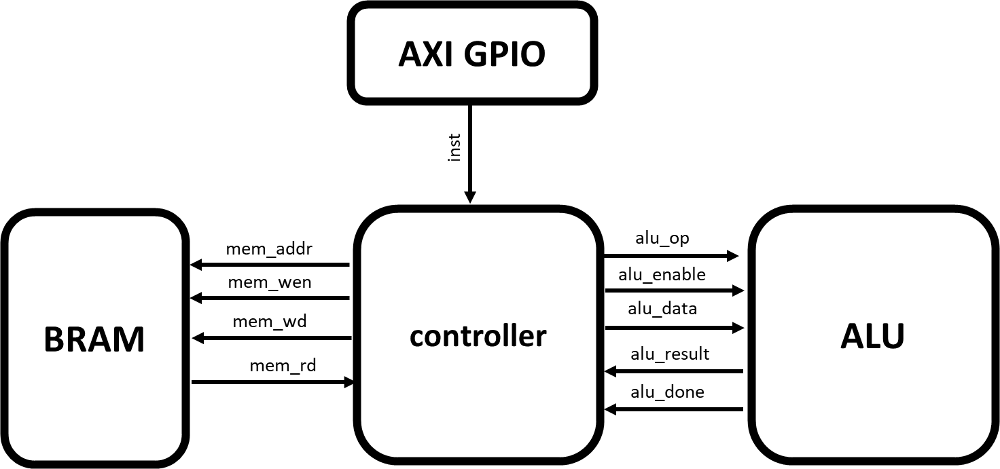
ECC System Hardware Architecture

Slide 26
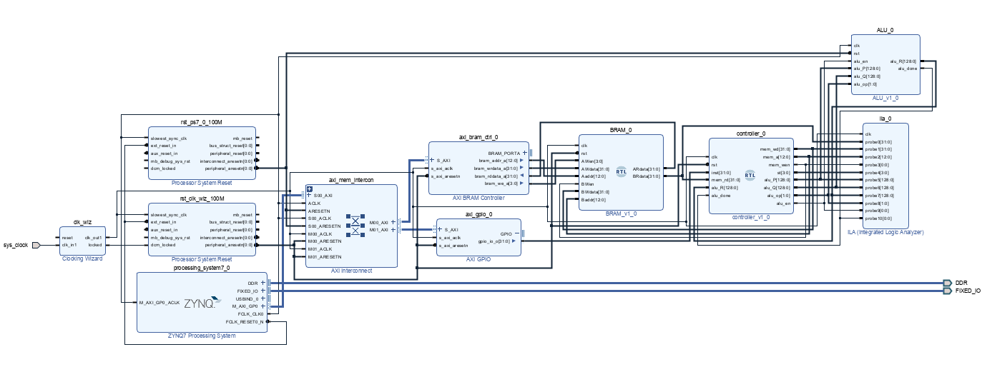
Block diagram

Slide 27
Outline
Introduction to ECC
Algorithm & Hardware Architecture
Design features
Result
Problems to occur

Slide 28
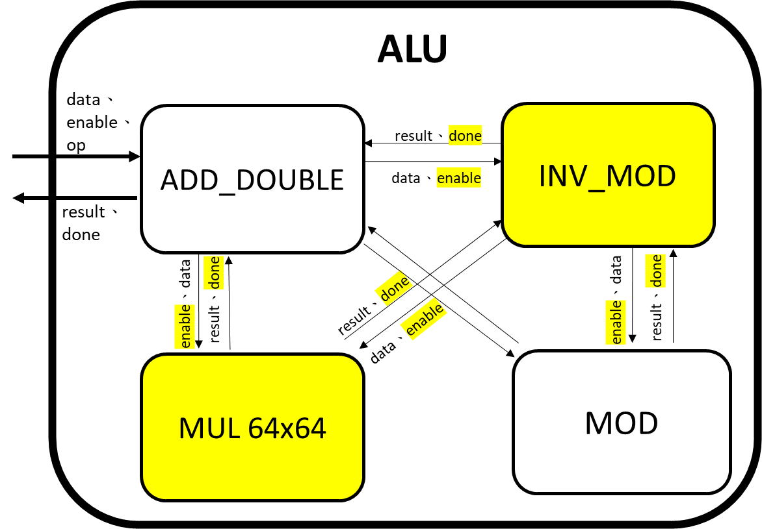
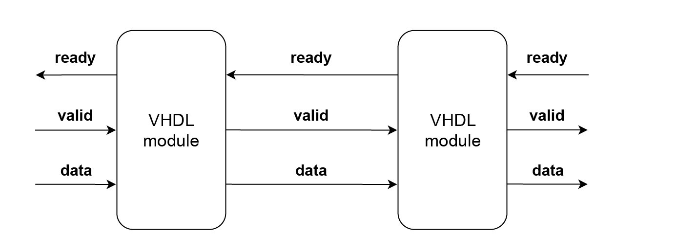
Resource sharing
Use handshake and stall to share hardware

Slide 29
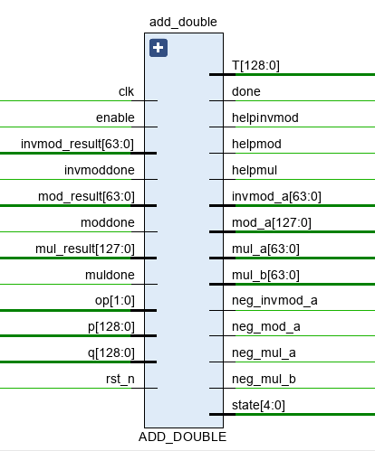
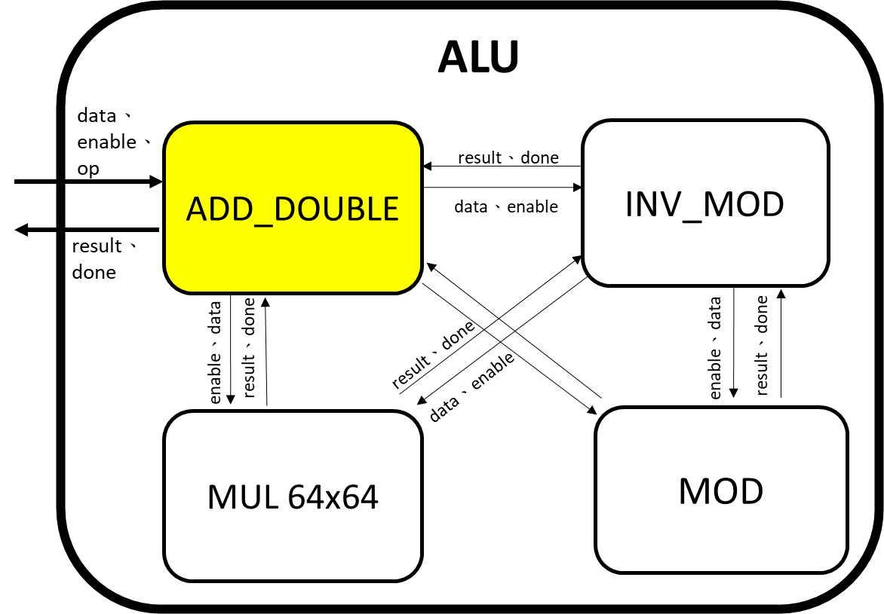
Resource sharing
Merge the similar function hardware to one module

Slide 30
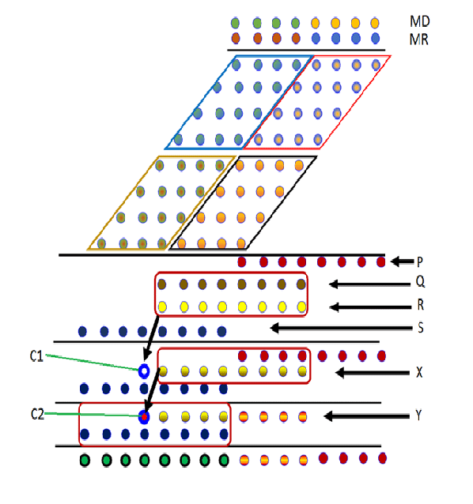
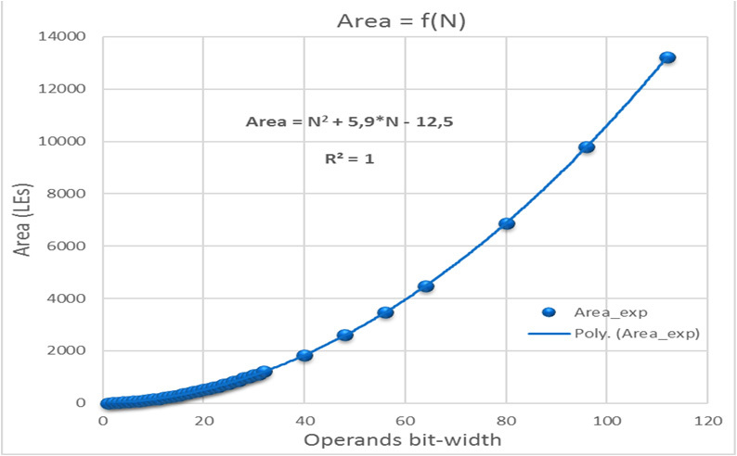
Resource sharing
Use wallace tree multiplier and sequential divider to solve large number calculation and share its sub-multiplier

Slide 31
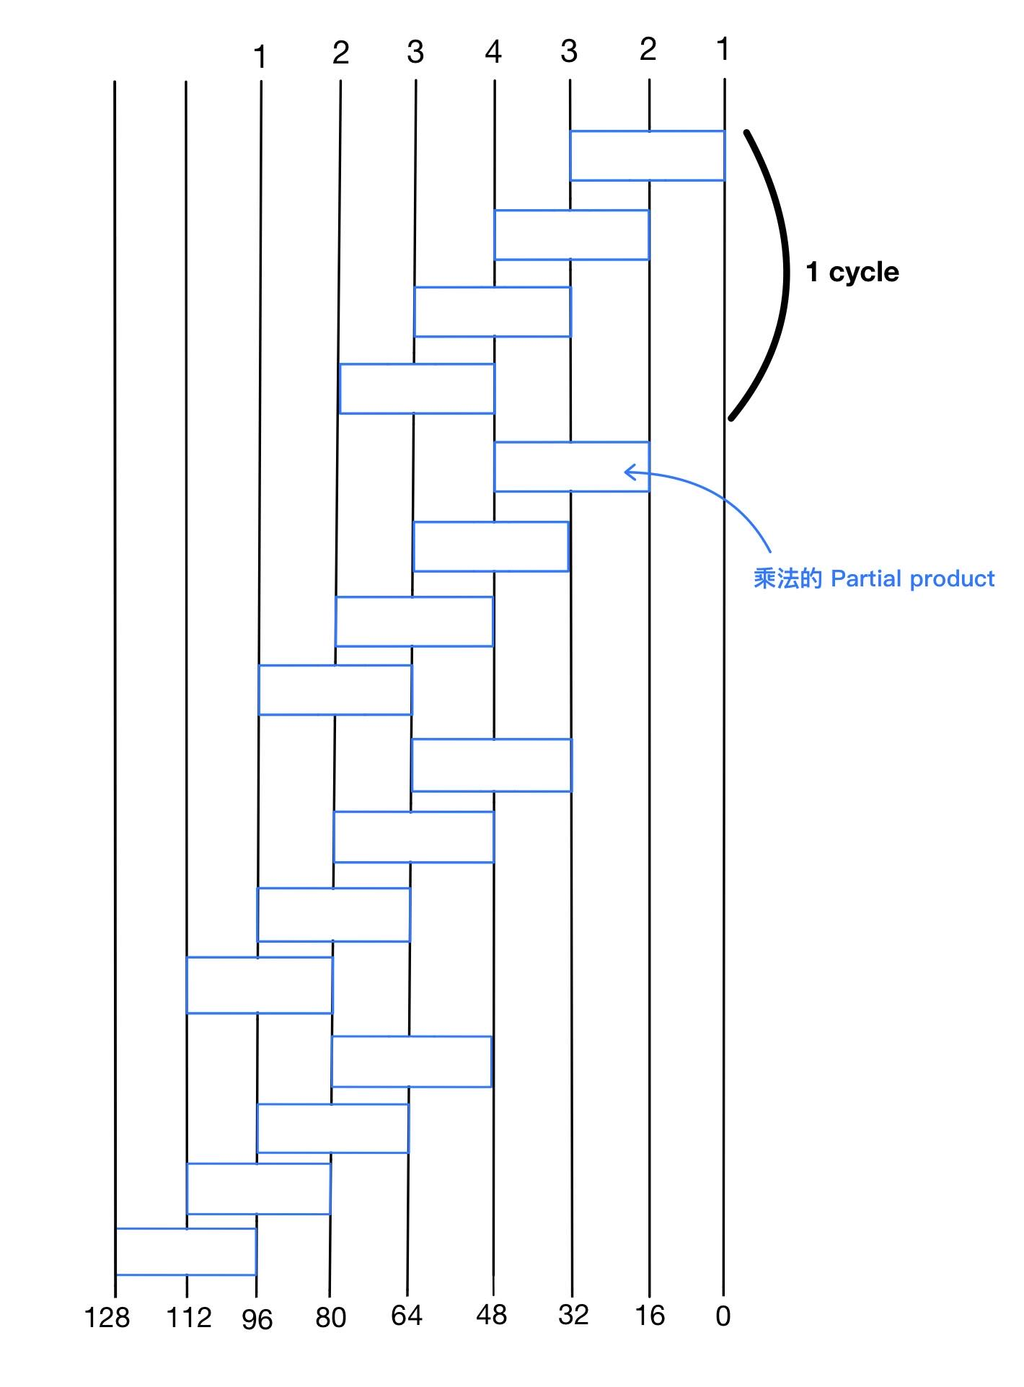
parallelism of small DSP multiplier
With split 64*64 multiplier into four 16*16 multiplier run four stage rather than four 32*32 multiplier run one stage
Reduce critical path & period
Can use DSP module in FPGA rather than LUT
Area decreases significantly

Slide 32
Outline
Introduction to ECC
Algorithm & Hardware Architecture
Design features
Results
Problems to occur

Slide 33
Result
軟體執行(透過VITIS IDE 與硬體互動)
先將ECC的參數存入BRAM的指定位置
使用者輸入inst mode = 1 (generate key)利用私鑰k產生公鑰K
使用者輸入inst mode = 2 (encrypt) 並輸入公鑰、message(M)、random number來加密
使用者輸入inst mode = 3 (decrypt) 並輸入私鑰、被加密文件C1、C2來解密

Slide 34
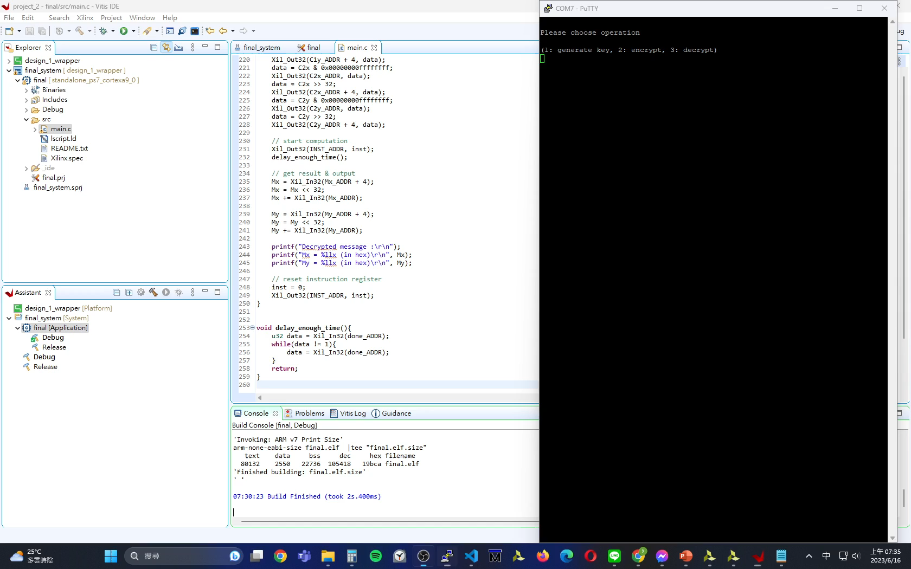
Demo

Slide 35
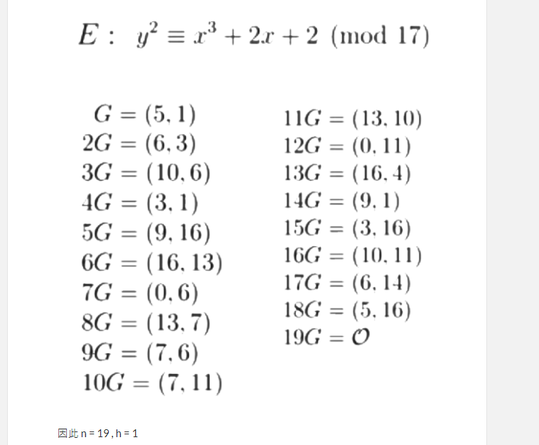
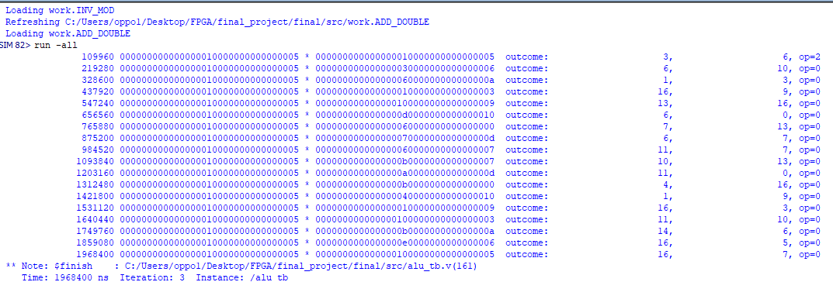
Result
With something encryption and decryption error
But with correct ECC arithmetic operation (ALU module)

Slide 36
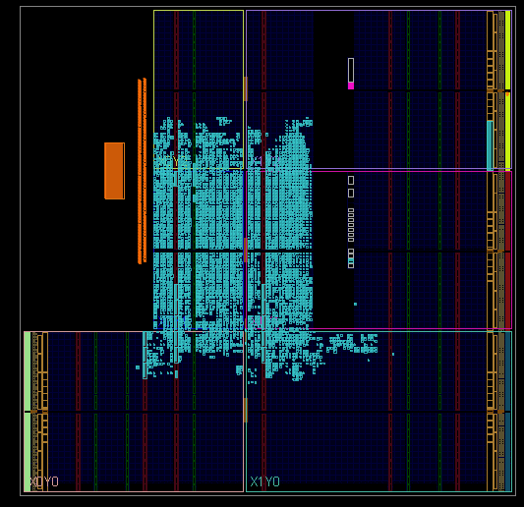
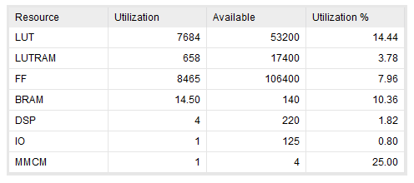
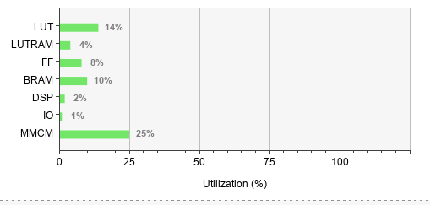
Utilization

Slide 37
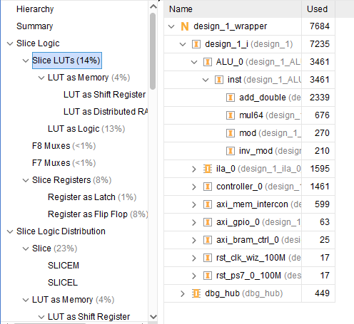
LUT Utilization
LUT utilization is dominated by add_double module
Multiply is replaced by DSP module in mul64
Mod area is dominated only two 128bits subtraction

Slide 38
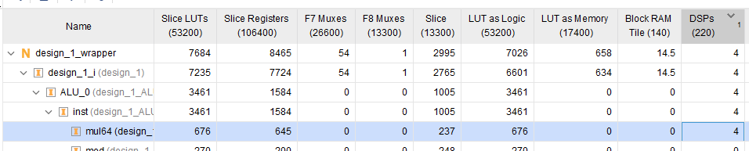
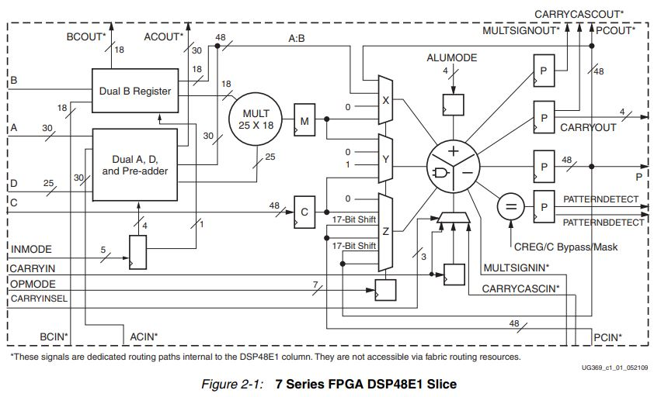
DSP Utilization
With split 64*64 multiplier into four 16*16 multiplier run four stage
mul64_a
temp_result
mul64_b

Slide 39
Outline
Introduction to ECC
Algorithm & Hardware Architecture
Results
Design features
Problems to occur

Slide 40
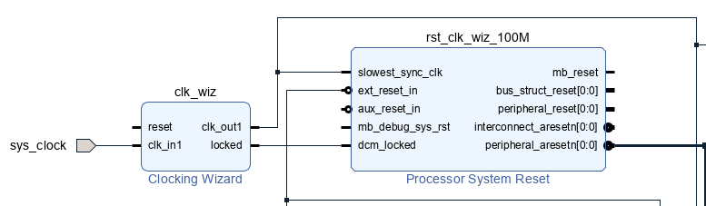
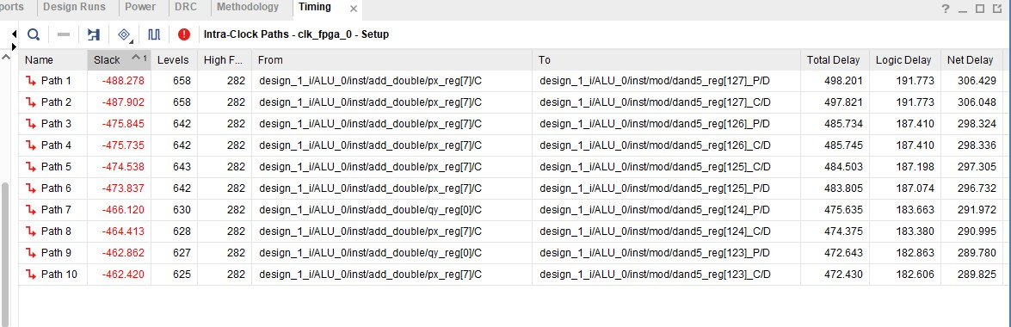
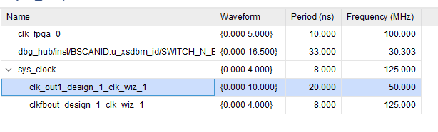
Setup time violation
(Sol)
將乘法器和除法器一個stage的critical path再縮短
使用clock wizard將clk period提高至slack>0

Slide 41
Tools with verification
large number calculator (* & mod)
https://www.calculator.net/big-number-calculator.html
inverse modulo calculator
https://keisan.casio.com/exec/system/15901266097609
ecc calculator
http://www.christelbach.com/eccalculator.aspx

Slide 42
Reference
Hardware design and implementation of ECC based crypto processor for low-area-applications on FPGA https://ieeexplore.ieee.org/abstract/document/8279005?fbclid=IwAR3y2Ey7g9STRfPIBXAQByA_J2NVTw2d140kOitqDdDAnMINuXb0hFFYOU4
非對稱式加密演算法 - 橢圓曲線密碼學 Elliptic Curve Cryptography , ECC (觀念篇)
https://ithelp.ithome.com.tw/articles/10251031
How can I best check these Elliptic Curve parameters are valid? https://stackoverflow.com/questions/22270485/how-can-i-best-check-these-elliptic-curve-parameters-are-valid
Elliptic Curve Cryptography (ECC) by Christof Paar https://www.youtube.com/watch?v=zTt4gvuQ6sY&t=4805s

Slide 43
Thanks for listening

